Slide 1

Housekeeping
Module 17 – Final Module
Please mute yourself if you are not speaking.
Feel free to include your pronouns in your Zoom Name.
Use Zoom reaction tools, chat box, hands up, etc.
Be prepared to have video on at all times; as such, please be appropriately dressed and limit distractions.
Contribute to the conversations out loud and in the chat box.
If someone has already shared what you were going to say, lower your hand and put “agree” in the chat.
Notes:
COORDINATOR
Read out Housekeeping slide.

Slide 2
Expectations
Module 17 – Final Module
Arrive on time.
Help us create a confidential, non-judgmental space (no screenshots or recordings).
Please keep your phones on silent.
Avoid cross-talk and side-talk.
Learn from each person’s perspective.
Language – please bring new language to us as we recognize that language is ever-changing.
Have fun!
From the group:
[ADD PARTICIPANT ADDITIONS, IF ANY]
Notes:
COORDINATOR
Read out Expectations slide.

Slide 3
Final Module
Module 17
Notes:
Trainer Manual
Module 17: Final Module © 2023 PeerWorks
This training program is designed to be accessible to all trainers, and ensure that all participants receive the same quality of education regardless of specific trainers’ background and experience.
This manual is a living document and should be understood as a set of guidelines, not as a fixed script. Feel free to adapt the language to your style of presentation. We also recognize that language is always changing; please update terminology when necessary. The synchronous sessions should be dynamic, engaging experiences.
TRAINER
Welcomes everyone and states the topic of today’s module.

Slide 4
Land Acknowledgement
Module 17 – Final Module
I am speaking to you today from Toronto. Toronto is in the 'Dish With One Spoon Territory’. The Dish With One Spoon is a treaty between the Anishinaabe, Mississaugas and Haudenosaunee that bound them to share the territory and protect the land. Subsequent Indigenous Nations and peoples, Europeans and all newcomers have been invited into this treaty in the spirit of peace, friendship and respect.
The "Dish", or sometimes it is called the "Bowl", represents what is now southern Ontario, from the Great Lakes to Quebec and from Lake Simcoe into the United States. *We all eat out of the Dish, all of us that share this territory, with only one spoon. That means we have to share the responsibility of ensuring the dish is never empty, which includes taking care of the land and the creatures we share it with. Importantly, there are no knives at the table, representing that we must keep the peace.
We want to acknowledge and respect all Indigenous people who don’t live in their traditional territories but have made a home in different parts of Ontario and have brought their culture with them.
Notes:
COORDINATOR
Read out PeerWorks’ land acknowledgement.

Slide 5

Icebreaker Activity
Module 17 – Final Module
What is your name?
Following this training, where do you see yourself in the world of peer support?
What are your goals and/or what role do you want to fulfill?
Notes:
TRAINER
“What is your name? What has been the most memorable part of the training program?”

Slide 6
Module Overview
Module 17 – Final Module
In Module 17 we will discuss the questions that you sent in, going over the internship, signing/reciting the code of conduct, and skills practice activity (time permitting).
Notes:
TRAINER
Read the Module Overview and Learning Objectives out loud or invite a participant to read it out loud.

Slide 7
Learning Objectives
Module 17 – Final Module
Through the successful completion of Module 17, you will have the skills and knowledge to:
Determine your suitability for the PeerWorks internship (if recommended)
Recommend Peer Support to your colleagues and friends.
Stay in touch with us and let us know how your Peer Support work is going.
Notes:
TRAINER
Read the Module Overview and Learning Objectives out loud or invite a participant to read it out loud.

Slide 8
Program Result & Internship Option
Module 17 – Final Module
Level 1 means the person attended and participated fully in the training and is deemed at this point appropriate to deliver an informal friendship style of peer support within supervised settings that would correspond with the first three categories in the Mental Health Commission of Canada’s Continuum of Peer Support, up to and including a C/SI or PSO.
Level 1R means that the trainers are of the opinion the participant may be ready to work in a more formalized setting and are Recommending that they proceed to an internship or practicum in which they deliver 50 hours of person-to-person support which is monitored and evaluated.
It is not mandatory to do the practicum, but it is necessary for those who wish to earn the PeerWorks Certified Peer Supporter certificate.
Save the date: Internship Webinar [Add date] at [Add time] EST
Notes:
COORDINATOR
Read out the slide about the possible grade you can get at the end of the training program and the option for the internship.

Slide 9

Module 17 – Final Module
WHAT QUESTIONS DO YOU HAVE ABOUT THE INTERNSHIP?
Notes:
COORDINATOR
Answer questions about the internship.

Slide 10
Internship Questions:
Module 17 – Final Module
[INSERT INTERNSHIP QUESTIONS HERE]
Notes:
COORDINATOR
Read out the slide about the possible grade you can get at the end of the training program and the option for the internship.

Slide 11
PeerWorks
Module 17 – Final Module
PeerWorks NewsToGo is an electronic newsletter which is focused on research, resources, policy and legislative information of relevance to consumer/survivor organizations and to broader stakeholders in the healthcare sector. You will also find updates about PeerWorks as well as job postings and events that would be of interest to the readership.
Membership: If you are part of an organization that has a PeerWorks organizational membership you do not need a separate individual membership to take advantage of membership benefits.
Membership fees range from $40 for individuals up to $250 for organizations. We do not want the fees to be a barrier to any individual or peer organization so if your organization has any problems with the fees please contact Allyson Theodorou at 1-866-681-6661 ext. 2.
Notes:
COORDINATOR
Read out the slide about PeerWorks NewsToGo and our membership.
Benefits of our membership include:
Access to our Communities of Practice
Vote in our elections. Bring your voice to the broader provincial tables.
Network with other Peer Supporters and allies.
Have your work profiled and promoted by PeerWorks.
Attend committees.
Access to our annual conference at a reduced rate.
Monthly webinars and educational resources.

Slide 12
Peer Support Canada Code of Conduct
Module 17 – Final Module
I will act ethically, according to the values and principles of peer support.
I will treat all people with respect and dignity.
I will respect human diversity and will foster non-discriminatory activities.
I will honour the rights, beliefs and personal values of individuals.
I will behave with honesty and integrity in providing support to peers.
I will respect the privacy of individuals and maintain confidentiality within the limitations of program policies and the law e.g. potential harm to self or others.
I will not knowingly expose a peer to harm.
I will not take advantage of the peer relationship for personal benefit, material or financial gain.
I will respect the boundaries of peer support work and will not engage in romantic or sexual relationships with the peers that I support.
I will not provide peer support in a manner that negatively affects the public’s confidence in peer support.
Notes:
COORDINATOR
Remind participants to sign Peer Support Canada’s Code of Conduct.

Slide 13
What questions do we have about peer support?
Module 17 – Final Module
Notes:
TRAINER
Bring up any questions that were emailed to you and ask “What other questions do we have about Peer Support?”

Slide 14
Peer Support Questions:
Module 17 – Final Module
[INSERT ADDITIONAL PEER SUPPORT QUESTIONS HERE]
Notes:
COORDINATOR
Remind participants to sign Peer Support Canada’s Code of Conduct.

Slide 15
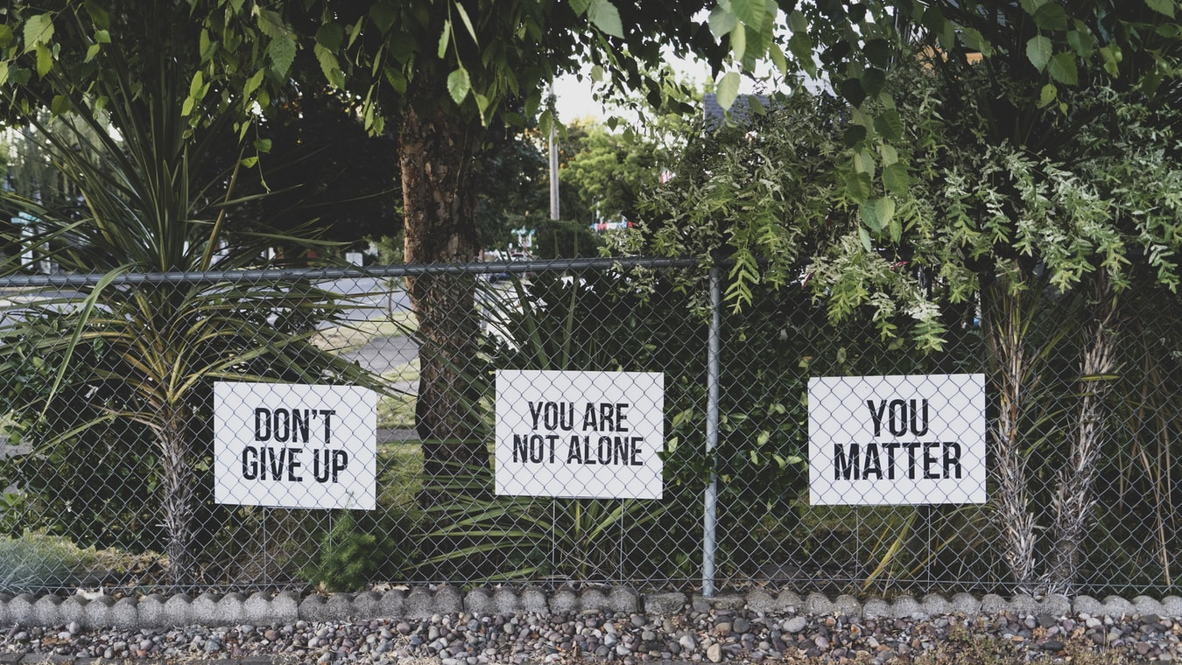
Notes:
TRAINER
Last slide is a visual representation of Peer Support. Transition into Pictionary.
You can use the whiteboard to play Pictionary and the participants can use the random word generator or think of words themselves.
https://randomwordgenerator.com/pictionary.php
Another option is to play “Two truths and a lie” if the group is not interested in playing Pictionary.
Thank everyone for their participation and encourage them to stay in touch.

Slide 16
Thank You
Notes:
TRAINER
Thank everyone for their time and ask if anyone has any final comments or questions that they want to bring forward.

